Slide 1
TABLEAU PROJECT
Covid 19 Spread Analysis of Indonesia

Slide 2
Column Names
Date
Province
New cases
New deaths
New recovered
New active cases
Total cases
Total deaths
Total recovered
Total new active cases
Island
Total cities
Total districts
Area(km)
Population
Population density
Case fatality rate
Case recovered rate
Growth factor of new cases
Growth factor of new deaths

Slide 3
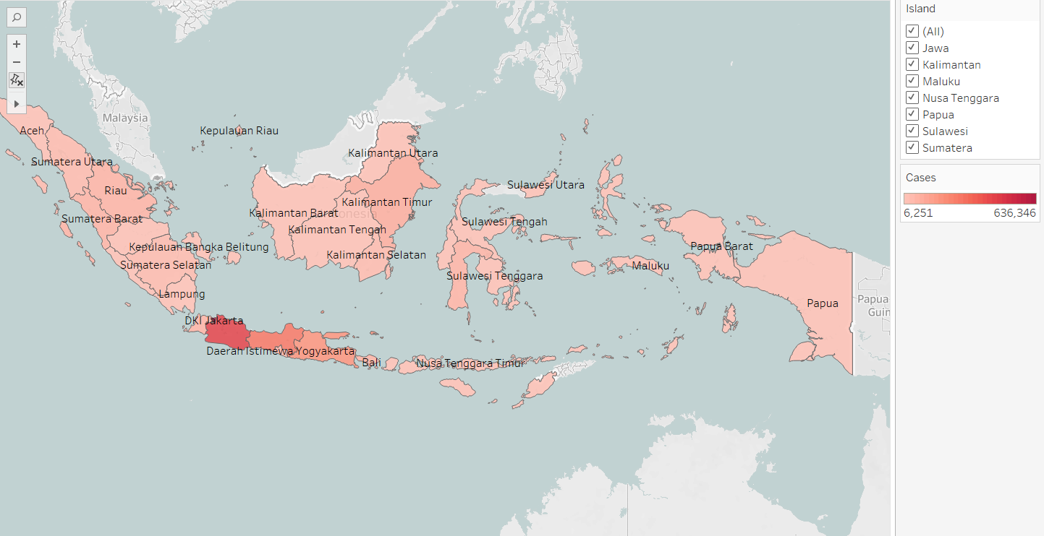
1. State wise information of confirmed cases in Indonesia
Of all the regions in Indonesia, Jawa island region is one of the worst affected.

Slide 4
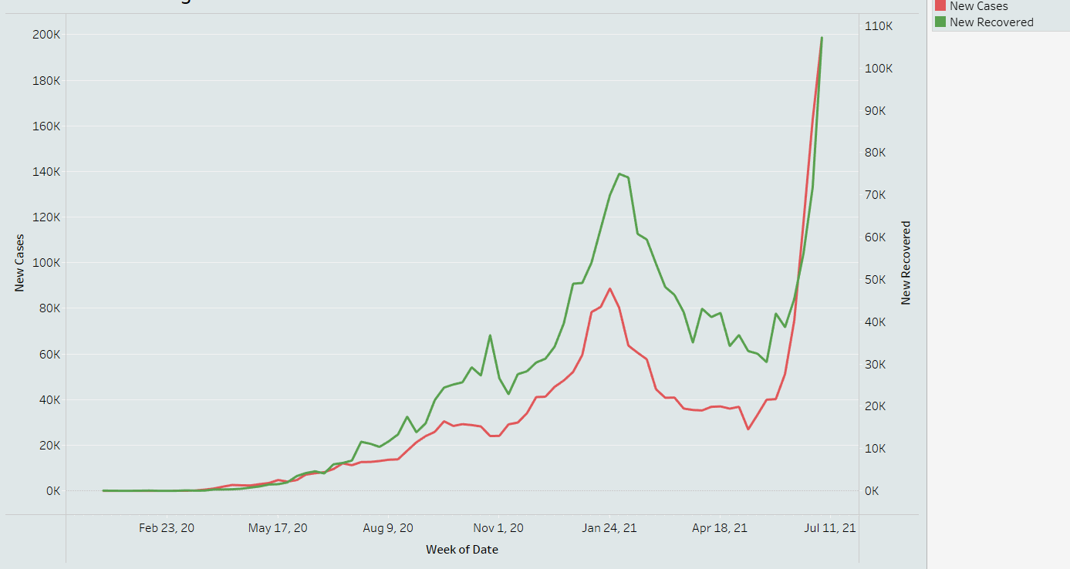
2. Daily incremental cases of Indonesia
For starting months new cases are growing rapidly and recoveries are slow but in November recovered cases are high. Covid 19 spread was high over January, 2021 and then decreased till Arpril,2021 and then it again increased with double speed.

Slide 5
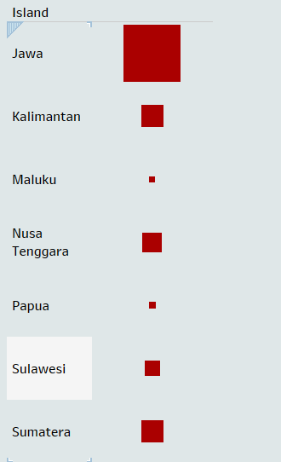
3. Island wise confirmed cases
Island Jawa of Indonesia
is highly impacted by Covid 19 here
observed large number of confirmed
cases.

Slide 6
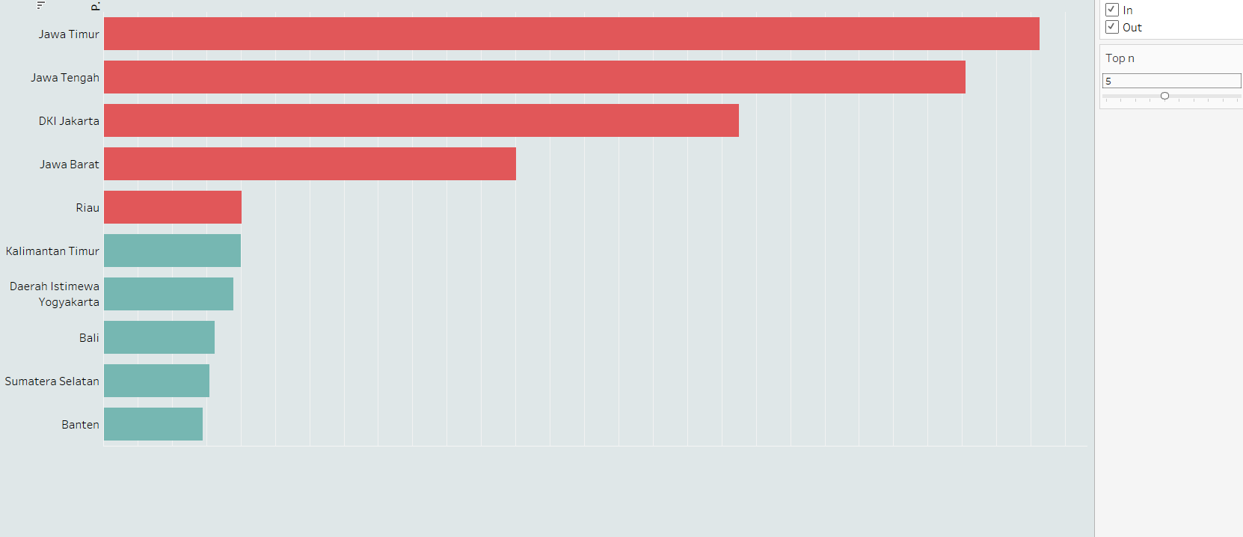
4.List of states having large number of deaths
Death count because of Covid 19 is highest in Jawa Timur state.

Slide 7
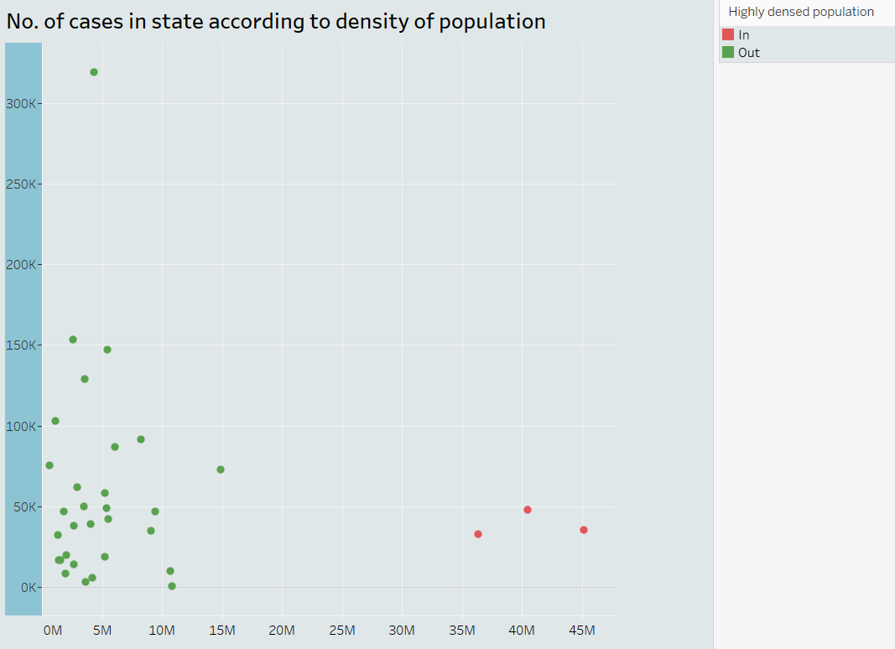
5. No. of cases in state according to density of population
The states which is highly densed according to population having large impact of Covid 19 .

Slide 8
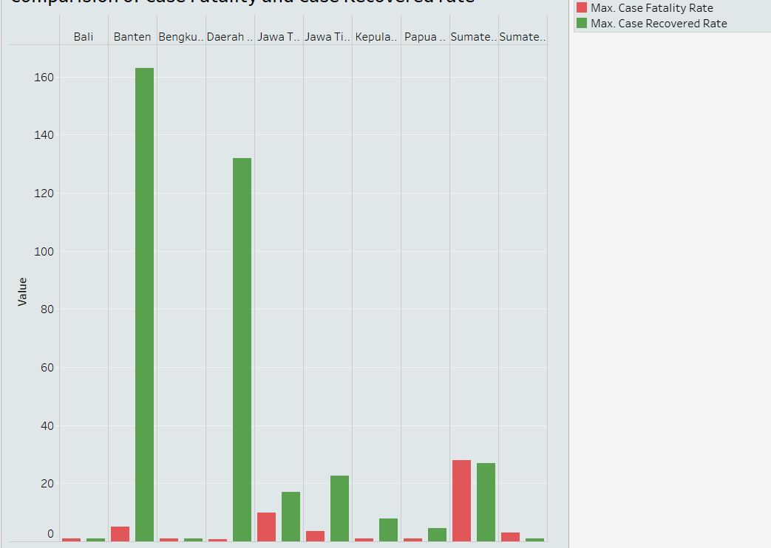
6.Comparision of Case Fatality and Case Recovered rate
Case recovered rate of Banten is highest among all states.
Case fatality rate of Sumatera selatan is highest among all states.

Slide 9
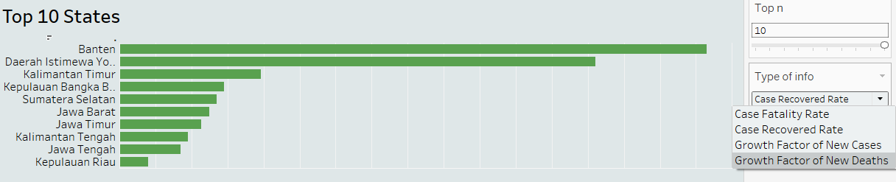
7.Top 10 states
According to Case fatality rate Sumatera selatan is on top.
According to Case recovered rate Banten is on top.
According to Growth factor of New cases Nusa Tenggara Timur is on top.
According to Growth factor of New Deaths Bali is on top.

Slide 10
Conclusion
DKI Jakarta state of Java Island region of Indonesia found large number of confirmed cases.
Covid 19 spread starts with January,2020 and the number of cases increases rapidly till January,2021 after that new cases decreases and furthermore by April it increases with double speed.
All the states of Island Jawa are highly impacted by Covid 19.
Jawa Timur states death count was highest among all the states.
There are three states which are highly densed according to population and that’s why Covid 19 is affected more on these states.
Banten state’s case recovered rate highest.
Sumatera Selatan state’s case fatality rate is highest.
According to Growth factor of New cases Nusa Tenggara Timur is on top.
According to Growth factor of New Deaths Bali is on top.

Slide 11
Dataset link: COVID-19 Indonesia Dataset | Kaggle Video link: https://drive.google.com/file/d/13EOkZIdBKwhHUfryXJUPsX7GAyyH8On9/view?usp=sharing

Slide 12
Dataset link:
COVID-19 Indonesia Dataset | Kaggle
Video link:
https://drive.google.com/file/d/13EOkZIdBKwhHUfryXJUPsX7GAyyH8On9/view?usp=sharing

Slide 13
THANK YOU

